Slide 1



Prime movers
SMART INDIA HACKATHON 2026
TITLE PAGE
Problem Statement ID – 26154
Problem Statement Title- Gen AI Platform for Automated Content Transformation
Theme- Blockchain & Cybersecurity
PS Category- Software
Team ID-
Team Name- Prime movers
Transforming Information into Intelligent Communication

Slide 2
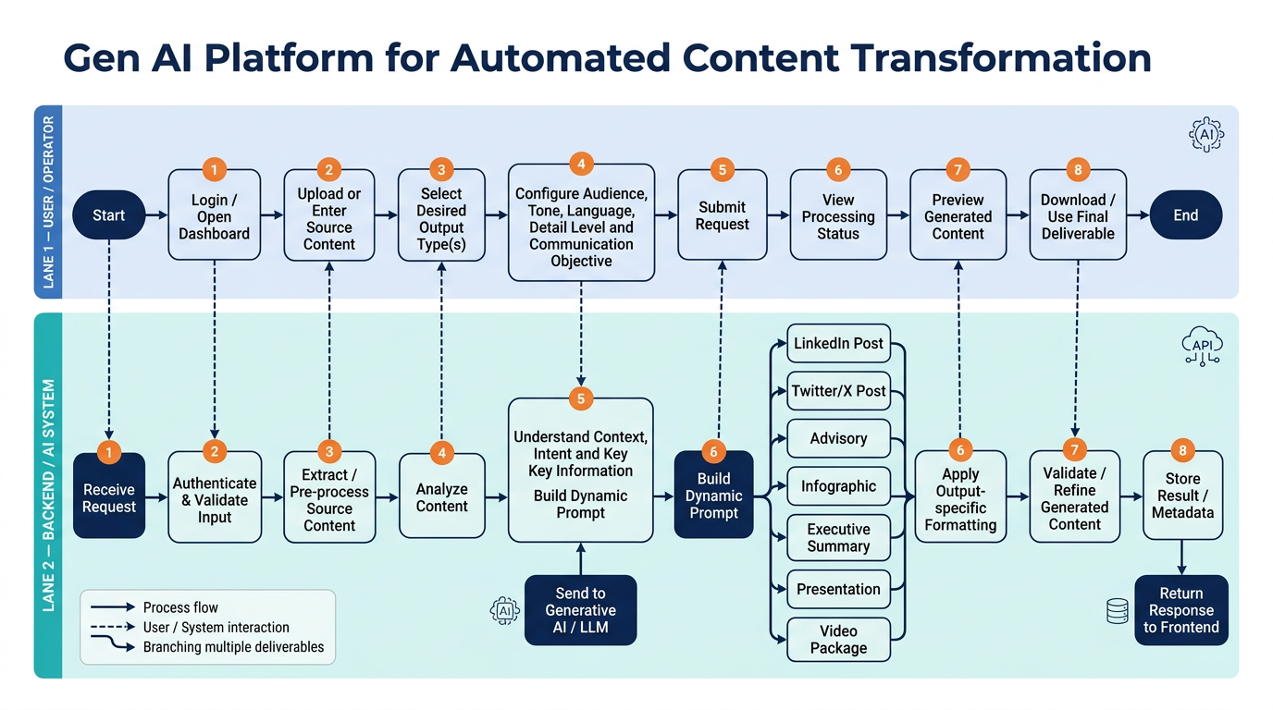
Prime movers
Gen AI Platform for Automated Content Transformation
Problem Overview
Multiple Content Formats → Reports, news, advisories, research
Manual Processing → Time-consuming & resource-intensive
Multiple Outputs → One source needs many formats
Expertise Required → Content + domain knowledge
No Unified Platform → Lack of configurable transformation
Core Problem:One Source → Multiple Deliverables → Too Much Manual Effort
GenAI Transformation Platform – Solution
Multi-Format Input → PDF, Text, Image, Video & Prompts
AI Content Understanding → Extracts context, intent & key information
One-Click Transformation → Select one or multiple output formats
Customizable Outputs → Audience, tone, language & detail level
AI Video Generation → Script → Scenes → Video → Subtitles
Multi-Platform Content → LinkedIn, X, Advisory, Infographic, Summary & PPT
One Source → Many Deliverables → Consistent content across formats
Unified Dashboard → Generate, preview, edit & export from one place
Transforming Information into Intelligent Communication
2

Slide 3
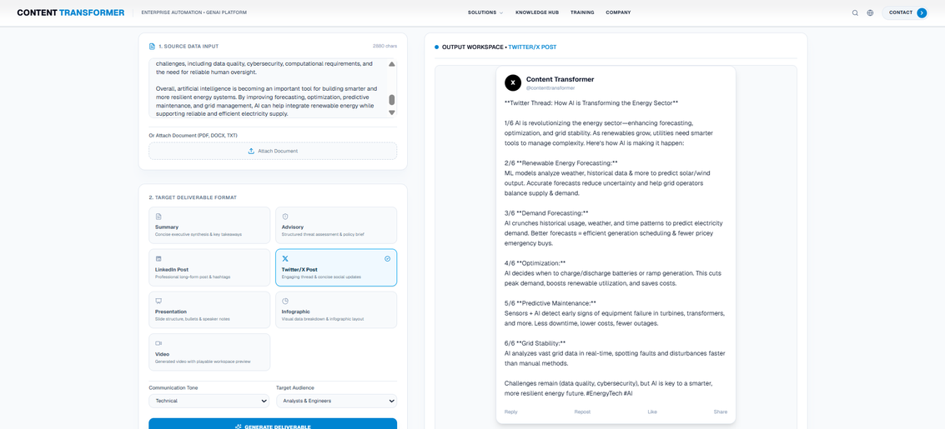
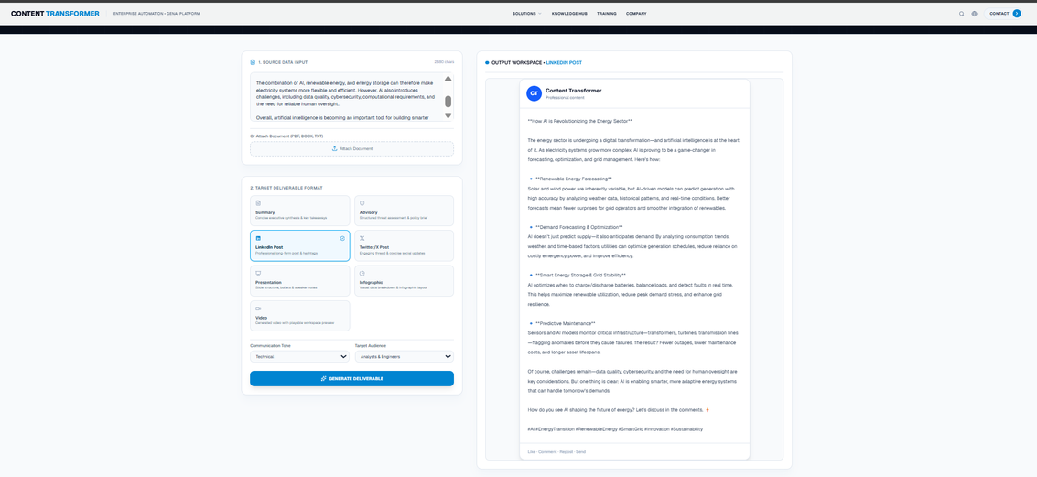
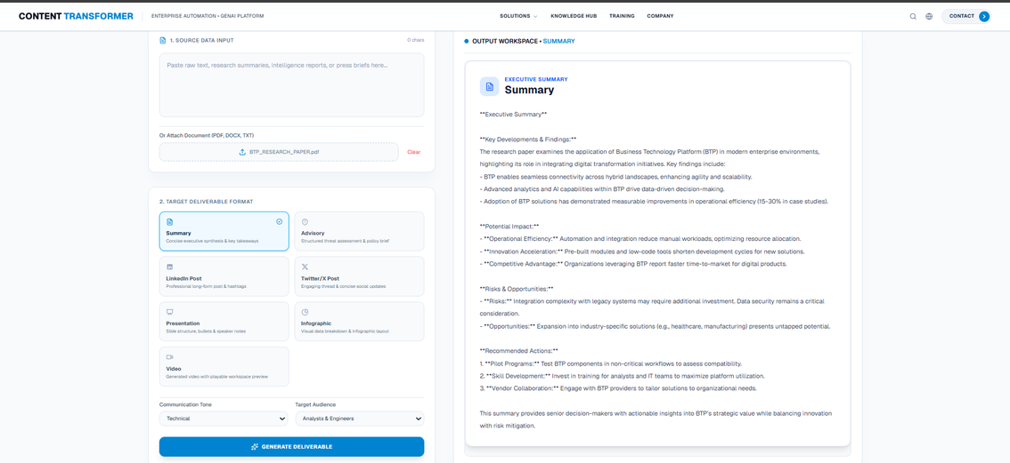
Prime movers
Core USP → “Create once. Transform everywhere.”
Transforming Information into Intelligent Communication
2

Slide 4

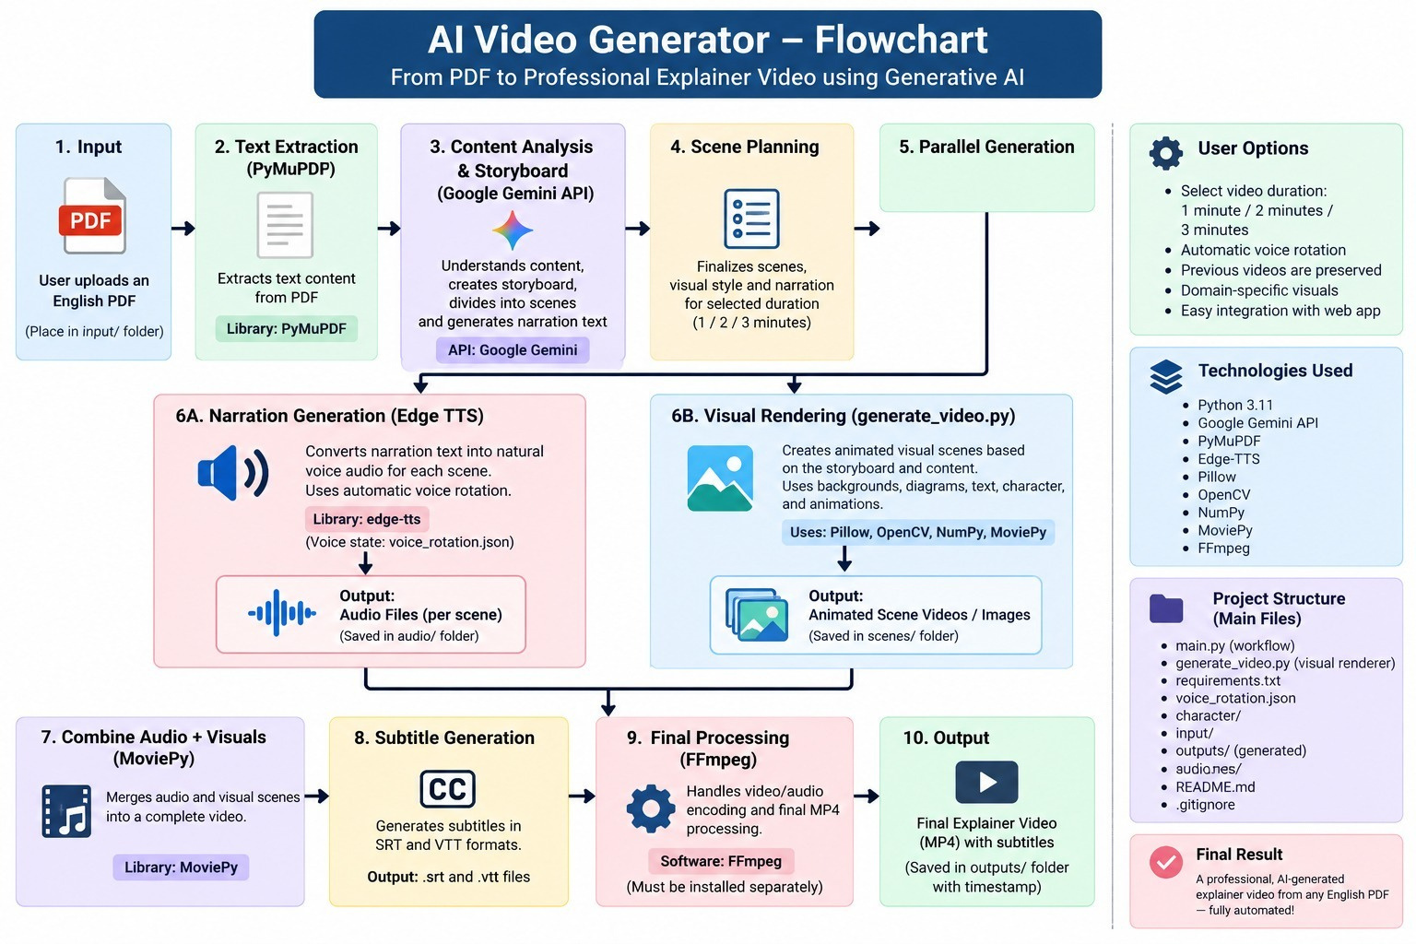


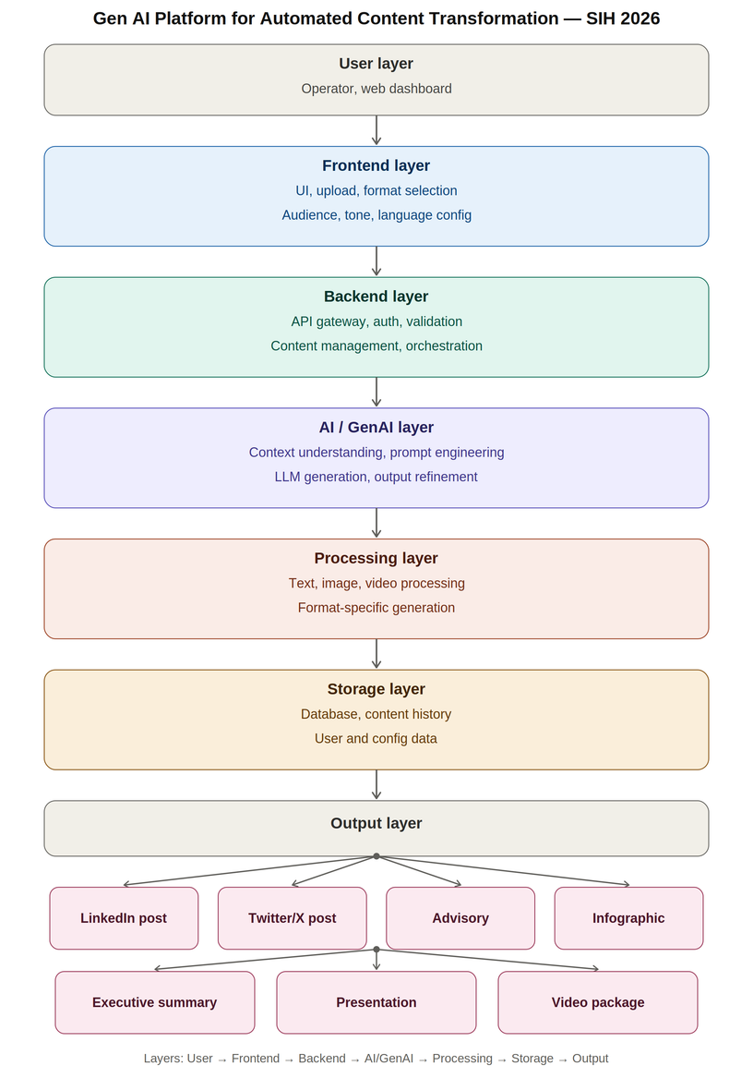





Prime movers
TECHNICAL APPROACH
Transforming Information into Intelligent Communication
3

Slide 5







Prime movers
FEASIBILITY AND VIABILITY
Use Cases
Feasibility
Challenges & Strategies
👤 Operators → Upload • Configure • Generate
🔍 Experts → Review • Validate • Refine
⚙️ Admins → Manage • Monitor • Audit
📢 Communication Teams → Publish • Share • Reuse
🤖 AI Engine → Understand • Transform • Validate
Technology → GenAI + APIs
Integration → Existing Systems
Scale → Cloud + Containers
Output → Multiple Formats
Control → Validation + Access
🧠 AI Accuracy → Hallucination risk
🔐 Data Security → Sensitive data leakage
📄 Content Complexity → Context loss
⚙️ Multi-Format → Output inconsistency
📈 Scalability → Higher API/infrastructure cost
Business Potential
1
PHASE 1
2
PHASE 2
3
PHASE 3
📈 Market → Enterprise GenAI + Content Automation
💰 Revenue → SaaS + API + Enterprise Licensing
🚀 Scale → Multi-user + Multi-format + Multi-organisation
⚡ Value → One Source → Multiple Outputs
INGESTION & INPUT CONFIGURATION
FEASIBILITY & CORE AI PROCESSING
GOVERNANCE, VALIDATION & SECURITY CONTROLS
• Source asset upload
• Operator configuration
• Initial context extraction by the AI engine
• Cloud container infrastructure
• GenAI APIs
• Existing system integrations
• Hallucination checks
• Data leakage prevention
• Expert review · admin monitoring · access controls
Viability (Long Term Success)
⚡ Efficiency → Less manual content work
🎯 Consistency → One source, consistent outputs
🌐 Scalability → Multi-user, multi-format, multi-organisation
🔐 Control → Validation + metadata + auditability
📢 Reach → Text + Social + Visual + Video
4
PHASE 4
5
PHASE 5
Government Support
MULTI-FORMAT OUTPUT & DISTRIBUTION
VIABILITY & BUSINESS OUTCOMES
🏛️ Government → Department-wide deployment
🔗 Integration → API-ready enterprise workflows
🛡️ Intelligence → Reports → Actionable communication
📢 Communication → One Source → Multiple Channels
• Automated text, social, visual & video generation
• Distribution through API-ready enterprise channels
• Manual work reduction
• Consistent messaging
• Multi-tenant scalability
• Licensing value
Transforming Information into Intelligent Communication
4

Slide 6



Prime movers
IMPACT AND BENEFITS
Potential Impact on the Target Audience
Benefits of the Solution
👤 Content Operators: Faster content creation & reduced manual effort.
🧠 Domain Experts: Easier review, validation & refinement of AI outputs.
📢 Communication Teams: Multiple formats from a single source.
🏢 Organisations: Consistent, scalable & streamlined communication.
🌐 End Users: Faster access to clear, audience-specific information.
🌐 Social Impact: Faster, consistent & accessible communication across languages and audiences.
💰 Economic Impact: Reduces manual content-production time, effort & operational costs.
🌱 Environmental Impact: Less paper-based documentation and reduced resource consumption.
📈 Organisational Impact: One source → multiple deliverables → higher productivity
Comparision Table
💡 What Matters | 🚀 Our Platform | 😓 Traditional Way | 🤖 Generic AI Tools | ❤️ Why It Matters
📥 Input | PDF • Text • Image • Video • Prompt | 📄 Manual reading | 📝 Mostly text | Anything in → Ready content out
🧠 Understanding | Context + Intent + Key Points | 👤 Human effort | 🤖 Basic understanding | Less chance of missing the message
🔄 Multiple Formats | 1 Source → 7+ Outputs | 😓 One-by-one | 🔁 Separate generation | Create once, use everywhere
🎯 Right Audience | Tone • Language • Detail • Objective | ✍️ Manual editing | ⚙️ Limited control | Same message, right communication
🎬 Video | Script → Scenes → Video → Subtitles | 🎥 Time-consuming | 🧩 Multiple tools | No tool-hopping
✅ Accuracy | AI + Human Review | 👤 Fully manual | ⚠️ User-dependent | Critical information gets reviewed
⚡ Speed | Automated workflow | 🐌 Slow & repetitive | ⚡ Faster but fragmented | Less time, more output
🏢 Scale | Multi-user + Multi-organisation | 👥 Needs more people | 🔒 Tool-dependent | Built for Govt. & Enterprise use
🔐 Control | Validation + Access + Metadata | 📂 Manual controls | ❓ Varies | Safer, controlled workflow
🌐 Final Use | Preview → Edit → Download → Publish | 📑 Manual formatting | 🔀 Multiple platforms | Ready-to-use communication
Transforming Information into Intelligent Communication
5

Slide 7

Prime movers
RESEARCH AND REFERENCES
Research / Source | Key Finding | Relevance to Our Solution | Link
McKinsey – Economic Potential of Generative AI | GenAI can create significant productivity gains, especially in content-heavy functions such as marketing, sales and knowledge work. (McKinsey & Company) | Supports our idea of automating repetitive content creation and transformation. | Full Research → McKinsey
UK Government – Assist: AI for Government Communicators | A secure GenAI tool is being used by government communicators for drafting, reviewing, planning and improving communication. (Government Communications) | Directly validates our government communication use case and human-review workflow. | Full Research → GOV.UK
U.S. GAO – GenAI Use at Federal Agencies | Reported GenAI use cases across selected agencies increased substantially, while agencies also identified privacy, policy and reliability challenges. (Government Accountability Office) | Supports the need for scalable AI + validation + security/governance in government environments. | Full Report → GAO
NIST – Generative AI Risk Management Framework | Provides guidance for identifying and managing GenAI-specific risks across the AI lifecycle. (NIST) | Supports our validation, controlled generation and responsible-AI approach. | Full Research → NIST
Springer – GenAI for Cyber Threat Intelligence | Reviews GenAI applications across security reports, threat intelligence and diverse cyber-data sources, while highlighting limitations and challenges. (Springer Link) | Strongly connects our platform to NTRO + Cybersecurity theme, especially transforming threat intelligence into actionable communication. | Full Research → Springer Nature
Springer – GenAI in Cybersecurity Operations | Research highlights GenAI's potential for threat detection and response, while noting risks such as incorrect outputs and misuse. (Springer Link) | Supports our AI + human validation model for sensitive cybersecurity content. | Full Research → Springer Nature
Transforming Information into Intelligent Communication
6

Slide 8
Prime movers
SMART INDIA HACKATHON 2025
TITLE PAGE
👤 Team Member | 💼 Primary Role | 🧩 Domain | 📋 Key Responsibilities
ARPITA PATEL | BACKEND DEVELOPER | 🤖 AI & DEVELOPMENT | SERVER SIDE SCRIPTING & INTEGRATION
MAYANK GUPTA | Operations & Domain Strategy | 💻 STRATEGY & METHOD STRUCTURAL THINKING | PPT MAKING & STRUCTURE DESIGNING
SUJIT KUMAR PATHAK | FRONTEND DEVELOPER | 🧠 DESIGN & LAYOUT | UI/UX DESIGNING
VANSH GARG | BACKEND DEVELOPER | 🤖 AI & DEVELOPMENT | SERVER SIDE SCRIPTING & INTEGRATION
VANSH TYAGI | BACKEND DEVELOPER | 🤖 AI & DEVELOPMENT | SERVER SIDE SCRIPTING & INTEGRATION
SHUBHAM | Operations & FRONTEND | 🏢 OPERATIONS & DESIGN | LAYOUT DESIGNING & PPT MAKING
THANKS FOR WATCHING

